Slide 1
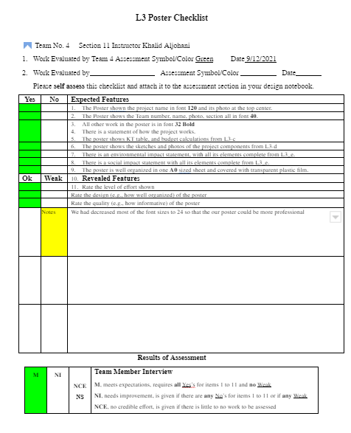

Slide 2
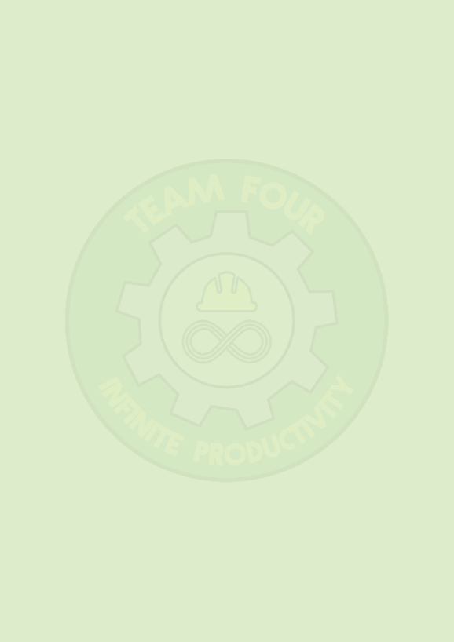
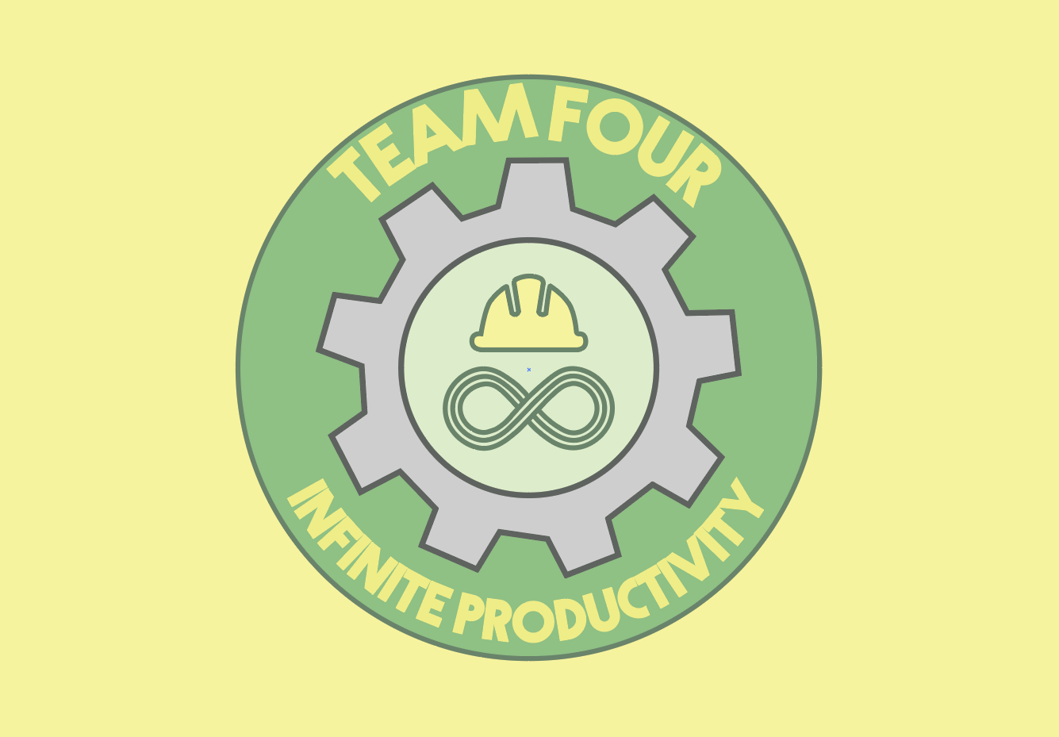

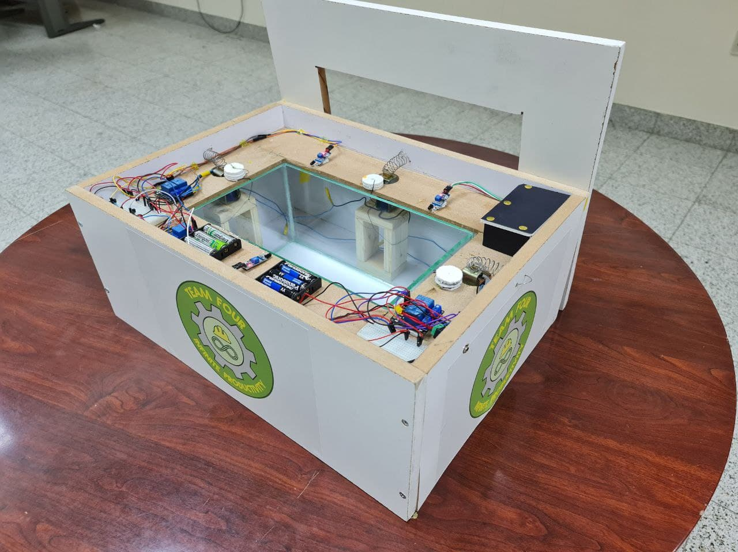
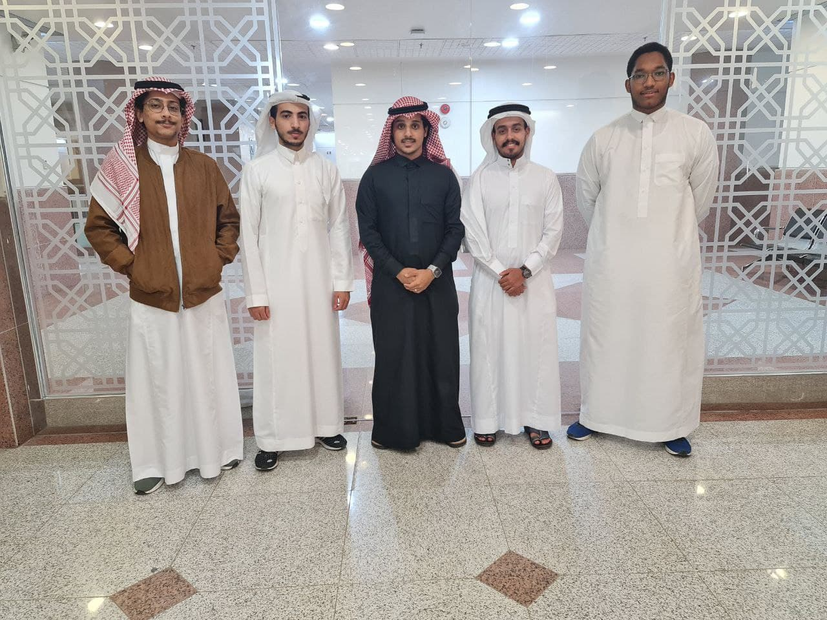
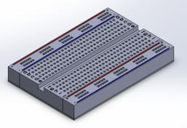
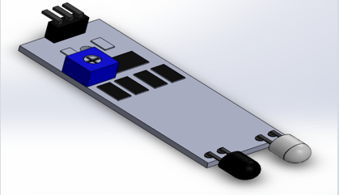
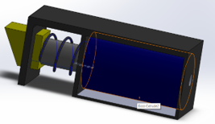

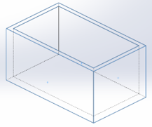
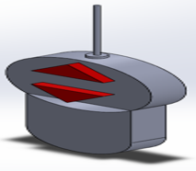
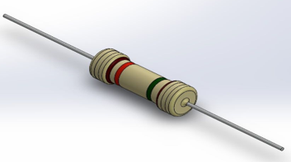
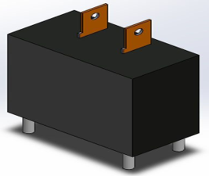
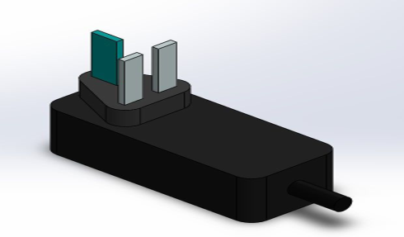
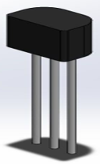
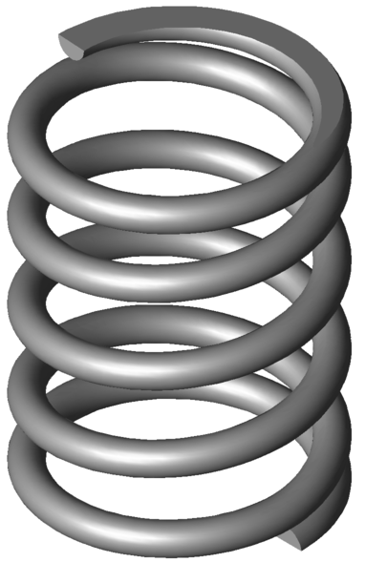
Swimmer Self-Rescue (SSR)
Instructor: Khalid Al-Johani | Year: 2021 | Term: Fall | Section: 11 | Team 4
Team Information
Project Picture
Team Picture
#ID | Name | Member
2142594 | Saad Salaheddin Alhassan | 1
2135582 | Sulaiman Fahad Alahmadi | 2
2135469 | Bader Sultan Al-ghamdi | 3
1937830 | Abdullah Babader | 4
2046405 | Osama Al-fifi | 5
KT Table
Project Description
Proposed budget for Idea 4
Idea | N
Make the floor able to rise in case of drowning . | 1
Make an auto whole that opens when there is 1.5 meter above it . | 2
Set up a drainage holes that opens automatically without manual intervention for a second mesh layer that allows water to pass through. | 3
Design a ring that has a button, so when the one who swims feels that he will drown, press this button so that the nearest one of the distributed machines around the pool sends a balloon to him . | 4
Design smart garbage that has an auto system which separates the waste according to their material type. | 5
Design a system that is consists of many sensors to indicate the cooking gas rate so when it increases above the allowed levels, the system turns off the electricity from the house, calls the police and opens holes to let the gas go out of the house. | 6
The Swimmer self-rescue is a device that saves lives from drowning in pools. Our project work mechanism is as follows: There are three Sensors around the pool that detects a certain range in the pool. These sensors are related to a Bracelet that contains two buttons. When the first button is pressed, A signal will be sent to the closest sensor that will send a float directly to the drowning person to lean on it. The second button will send a signal to the phone attached to the project to call the person who has a stored number on the phone
Cost | Number @ Rate | 1-Personal
240 SR | 12 hour @ 20.00 SR/hour | Team (5 members)
Cost | Number @ Rate | 2. Tools and equipment
- | Owned | Nails
4 SR | 1 hour @ 4 SR/ hour | Drill
- | Owned | Saw
0 SR | Free | Welding
Cost | Number@Rate | 3. Raw materials
60 SR | 3 item @ 20 SR/ item | 1- IR sensor
20 SR | 1 item @ 20 SR/ item | 2- Car toy with a remote
3 SR | 3 item @ 1 SR/ item | 3- Transistors (NPN)
34.5 SR | 3 package @ 11.5 SR Per 1 | 4- Connecting wires
8 SR | 8 item @ 1 SR / item | 5- Batteries
20 SR | 1 package @ 20 SR | 6- Resistors
30 SR | 2 item @ 15 SR/ item | 7- Small breadboard
75 SR | 5 item @ 15 SR / item | 8- Relay (5V)
20 SR | 1 item @ 20 SR / item | 9- Power Supply
3 SR | 3 meters @ 1 SR/ meter | 10- Long Wires
Alternative Ideas
6 | 5 | 4 | 3 | 2 | 1 | Musts
NO GO | NO GO | GO | GO | GO | GO | 1. The project cost should not exceed 2000SR
NO GO | NO GO | GO | NO GO | GO | GO | 2. Project should not depend on advanced programing
NO GO | NO GO | GO | GO | GO | GO | 3. Project duration is not more than one and a half months.
GO | GO | GO | NO GO | GO | GO | 4. Every member is convinced with the idea.
GO | GO | GO | GO | GO | GO | 5. Transactions according to Islamic law.
GO | GO | GO | GO | GO | GO | 6. It does not cause side effects.
NO GO | NO GO | GO | GO | GO | GO | 7. Project doesn’t require more than 30 equipment.
GO | NO GO | GO | GO | GO | GO | 8.Serve human safety purposes
NO GO | NO GO | GO | NO GO | GO | GO | 9.The project has been approved by the instructor.
NO GO | NO GO | GO | NO GO | GO | GO | 10. Project will be done by the team four only.
10 SR | 2 item @ 5 SR / item | 11- Battery holders
70 SR | 1 item @ 70 SR/ item | 12- Used cell Phone
3 SR | 1 item @ 130 SR/ item | 13- Wooden box
130SR | 30 item @ 0.5 SR/ item | 14- Connecting wires
30 SR | 3 item @ 10 SR/ item | 15- Spring
70 SR | 1 item @ 70 SR/ item | 16- Fishbowl
103.5 SR | 3 item @ 34.5 SR/ item | 17- Electrical locker
Idea4 |  | Idea2 |  | Idea1
Score | Rating | Score | Rating | Score | Rating | Weight | Wants
20 | 4 | 50 | 10 | 35 | 7 | 5 | 1. Project design is environmental.
80 | 10 | 32 | 4 | 80 | 10 | 8 | 2. The project helps save lives.
60 | 10 | 60 | 10 | 30 | 5 | 6 | 3. Simple design.
50 | 10 | 50 | 10 | 50 | 10 | 5 | 4. project involves wireless technology.
90 | 10 | 90 | 10 | 90 | 10 | 9 | 5. The project is long-life term.
100 | 10 | 100 | 10 | 100 | 10 | 10 | 6. Pieces in Jeddah range.
80 | 8 | 100 | 10 | 80 | 8 | 10 | 7. The project activated in no time.
100 | 10 | 100 | 10 | 100 | 10 | 10 | 8. Could use an outer help if needed.
60 | 10 | 60 | 10 | 54 | 9 | 6 | 9. Working with less noticeable sound.
80 | 10 | 80 | 10 | 80 | 10 | 8 | 10.High quality materials
30 | 10 | 24 | 8 | 18 | 6 | 3 | 11. Can move easily.
14 | 7 | 16 | 8 | 10 | 5 | 2 | 12. The project has a good looking.
100 | 10 | 90 | 9 | 80 | 8 | 10 | 13.The project should be interesting.
70 | 10 | 70 | 10 | 70 | 10 | 7 | 14.The project doesn’t use fossil fuel.
90 | 10 | 90 | 10 | 90 | 10 | 9 | 15.It should be scalable in the future.
Total=1024 |  | Total=1012 |  | Total=967
Cost | Number@Rate | 4. Additional cost
60 SR | 1 item @ 60SR/ lifetime use | Every Circuit
Cost | Number @ Rate | 5. Supplies
15 SR | 1 time @ 15 SR / time | Amazon, car toy delivery
1006 SR | Total artifact cost
Social Impact
It is our job to make people feel safe around our project, to do that we made a list of positives of our project and a list of negatives with mitigation plans to improve our project. By doing that, our project might almost get zero rate mistakes.
Positives
The project does not emit smoke that is harmful to the person. | It helps making lifeguard's mission easier. | Rescue more that one person at the same time. | Reducing drownings cases. | When a person sees the project, he will feel that swimming is safer.
Environmental Impacts
We made our project in a way that can suit the environment in many ways so that we can protect the environment. Meanwhile, our project does have some negative issues that might harm the environment. So now we’ll discuss the positives of our project and we’ll put a mitigation plan for every negative point.
mitigation | Negative impact
Put a poster on the project to remind the danger of depending so much on the project. | When the people depend so much on the project then it might reduce awareness of the dangers of swimming.
Prove that the project made of high-quality material. | People distrust the project for the fear of mechanical failure which lead to fear of swimming.
Use of solar powered batteries and use backup battery. | The project depends on electricity which leads to decrees the percentage of swimming safety.
Remind them that even if the project exists there still a probability of drowning. | Decrease the effectiveness of the swimming lifeguards.
Make the project larger to fit the big pools. | It is hard to appley in big pools that will make the small pools much crowded.
Positives
Save lives | The project has low chemical components that might be harmful | Most of the parts of the project can be recycled | The project has low percentage of ignition. | The project does not produce harmful gases.
Mitigation | Negative impact
Using small components | It might take a space of the pool
Use of insulators and protection systems | Some parts of the project are quick to rust and corrode
Reducing the outer hole of the spring | The spring might fly and hit someone
Use components that has less radiation | There might be a radiation side affect
Use solar power instead of electricity | The project consumes a large amount of energy
Project Components
11 | 10 | 9 | 8 | 7 | 6 | 5 | 4 | 3 | 2 | 1 | No.
Spring | Transistor | Power Supply | Relay | Resistor | Remote Control | Fish-Bowl | Wires | Electrical Locker | IR Sensor | Breadboard | Part name
 |  |  |  |  |  |  |  |  |  |  | Component Picture
Team’s website | Team’s Email
https://2u.pw/AY1QZ | Pioneersteam4@gmail.com

